Slide 1
Robotic Systems COMSM4111
Unit Introduction
Delivered by:
Paul O’Dowd (full time) paul.odowd@bristol.ac.uk
Martin Garrad (part time)
Unit Directors:
Seth Bullock seth.bullock@Bristol.ac.uk
Arthur Richards arthur.Richards@Bristol.ac.uk
Notes:
Welcome!
These slides introduce the unit.

Slide 2
House-Keeping:
Timetables
Blackboard
New Unit design
Assessment Points on BB in progress.
Anonymous Feedback form:
https://forms.gle/PyQQy2mwzyATFmJW6
Padlet board (questions & comments):
http://padlet.com/paul_odowd1/1lhoodwv2fuc

Slide 3
Agenda:
Introduce the Romi & Coursework
Introduce Unit format for the next 7 weeks.
Discuss Assessment 1 structure
Advice for working within Robotics
Expectations & Outcomes
Q&A

Slide 4
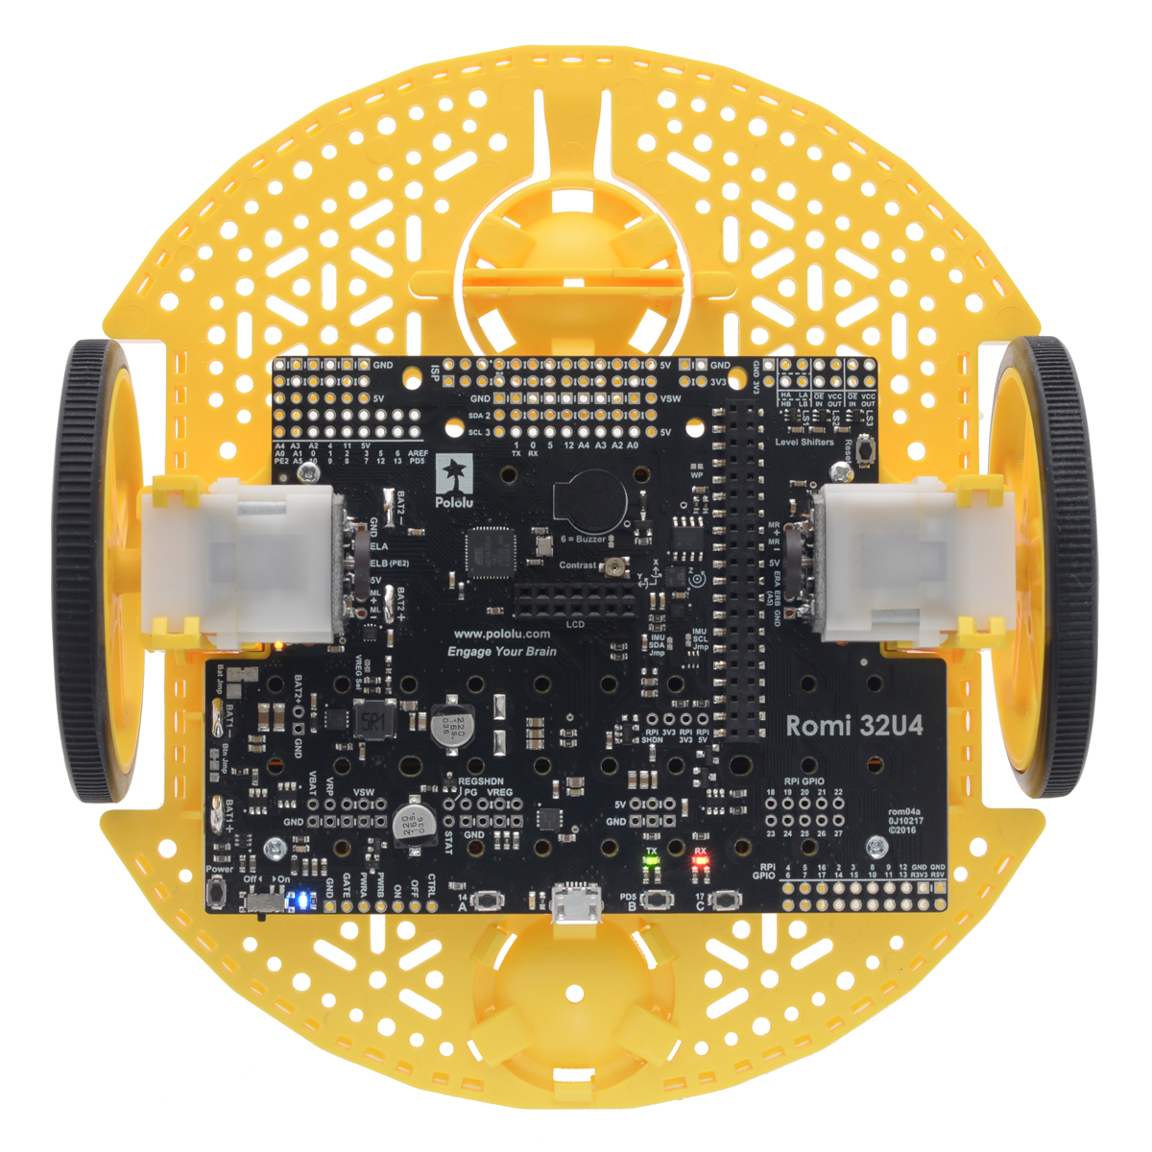
Meet the Romi!
Notes:
A brief description of the robot.
More info:
https://www.pololu.com/category/202/romi-chassis-and-accessories
Paul will throw some questions to the audience to engage thinking inline with Unit Objectives, e.g.
(Show of hands) How many people studied robotics before the MSc?
(Show of hands) How many people keep a log-book or journal of their work?
(Show of hands) How many people want to go into research with robotics?
(Show of hands) How many people want to go into industry with robotics?

Slide 5
Who is on the Unit?

Slide 6
100% Coursework
40% Assessment 1: Individual Basis, Line Following Task
Weeks 1 - 7
3 Assessment Opportunities, Doodle-poll sign-ups (30th Oct, 6th Nov, 13th Nov)
Individual Demonstration (mandatory)
Your code to uploaded Blackboard (mandatory)
60% Assessment 2: Group Work, Robotics Experiment
Weeks 8 - 12
8 – 10 page Report, 1 per group,
Report due via Blackboard, 6pm Wednesday 18th December.
Robot Demo – 10 minutes, Thursday 12th December.
Groups of 4 people – declare on Blackboard deadline 14th Nov (Week 7).

Slide 7
This Unit in Overview: 4 Key Skills
Break down a problem into smaller parts (technical or task)
Construct experiments to better understand a problem
Develop potential solutions
Evaluate and justify your solution to others
Assessment 1
Lectures + Labsheets
Robot Demo:
Line Following
Notes:
For CW1, we have designed the labsheets to teach you how to break up problems and design experiments.
Each lab sheet will guide you through a process of investigating a piece of technology.
By the end, you should have used everything you need for the CW1 challenge.
It finishes with you demonstrating your potential solution.

Slide 8
This Unit in Overview: 4 Key Skills
Break down a problem into smaller parts (technical or task)
Construct experiments to better understand a problem
Develop potential solutions
Evaluate and justify your solution to others
Assessment 2
Self-Directed
Group Work
Group Report:
Robotics Experiment
On Theme of Mapping
Notes:
CW2 is open-ended.
The coursework does not have a clear single solution.
We would like you to isolate an interesting problem, to design a solution around it, and then evaluate your solution.
It might be most useful to consider yourself and proposing a solution to a funding body.
They would want to know why your solution is worth investing in, and why you spent so much time/money designing it.

Slide 9
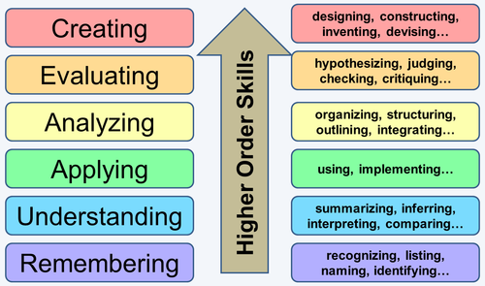
Learning Theory: Blooms Taxonomy (the way we designed this unit)
Assessment 2
Freedom to
Explore &
Demonstrate
Higher Understanding
Assessment 1
Driving Lessons
Driving Test

Slide 10
Kit Hand Out
Tomorrow’s Lab Session:
TA’s will come to you with a Romi.
Run the self-test (IR sensor and Line Sensor tested later).
Upload an example sketch from within the Arduino IDE.
Start Labsheet 1 Meet the Romi
Take care of your robot
Expect a week minimum for robot repairs / replacements
If the Romi has a problem:
Upload Romi self-test Serial output to Blackboard.
Describe problem.
Notes:
Martin and Paul have designed this coursework, it is all new, including the robots.
We thought it would be awesome for every student to have a robot.
However there are logistical/practical challenges to this unit.
It is our first time trying to solve these problems – we hope we get it right.
If something goes wrong - don’t panic – we’re human, we will make compensations for anything grade related.
Be patient – we will be doing our best to solve problems as quickly as possible.
We will do a staggered release of robots. Releasing 83 robots this week - paired working for first 3 weeks.
Please look on Blackboard for the release schedule to see if you must come and collect a robot this Thursday.
Please take care of your robot. It will take a minimum of 1 week to fix a robot - this is a practical reality to fixing a robot.
If there is a problem: There may be faults with the robots, so breaking happens. Don’t feel bad about it.

Slide 11
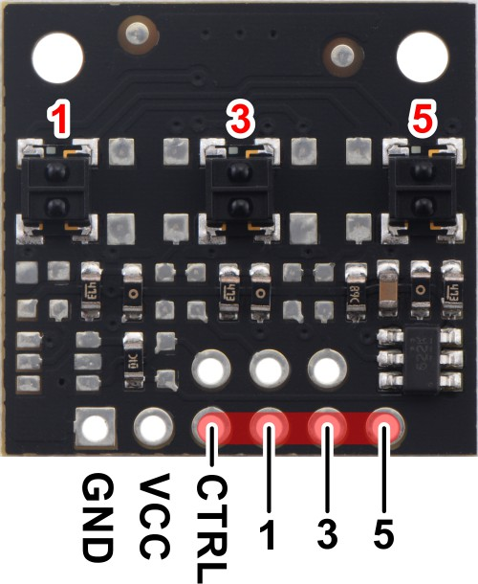
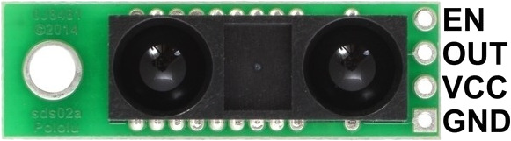
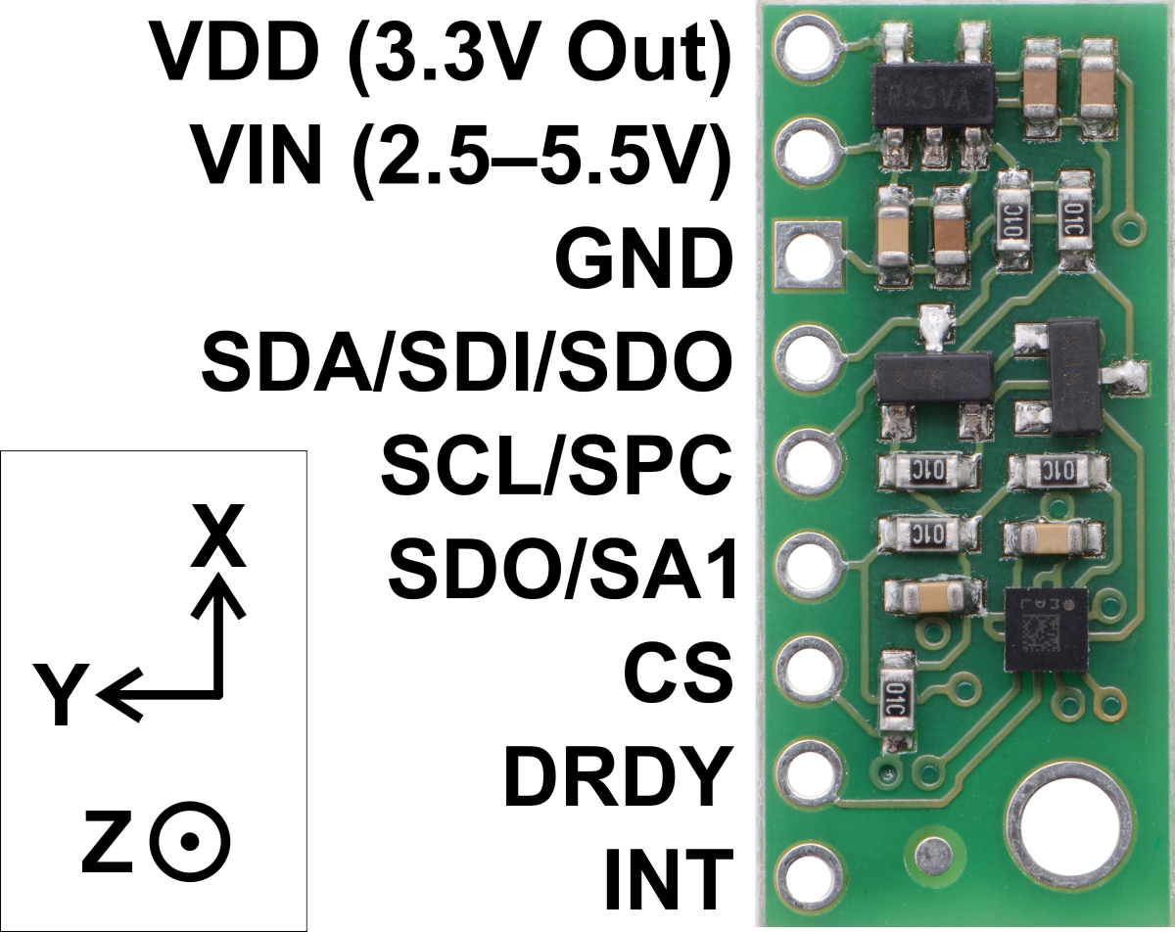
Kit Hand Out
1x Romi
1x Line Sensor
1x IR Proximity Sensor
1x Compass Sensor
1x USB Cable
5x connecting wires
6x AA Batteries
Box to Keep it all in
Notes:
Martin and Paul have designed this coursework, it is all new, including the robots.
We thought it would be awesome for every student to have a robot.
However there are logistical/practical challenges to this unit.
It is our first time trying to solve these problems – we hope we get it right.
If something goes wrong - don’t panic – we’re human, we will make compensations for anything grade related.
Be patient – we will be doing our best to solve problems as quickly as possible.
We will do a staggered release of robots. Releasing 83 robots this week - paired working for first 3 weeks.
Please look on Blackboard for the release schedule to see if you must come and collect a robot this Thursday.
Please take care of your robot. It will take a minimum of 1 week to fix a robot - this is a practical reality to fixing a robot.
If there is a problem: There may be faults with the robots, so breaking happens. Don’t feel bad about it.

Slide 12
Assessment 1 Demo
Notes:
Martin and Paul are going to do some live-coding during this lecture series – wish us luck!
In this slide, we will demo the Romi Robot completing coursework 1.
We will also briefly look at some code.
If you find the code confusing, then we recommend you come to the MSc Drop In session on Tuesday 29th Jan, 1pm.

Slide 13
Lab Sessions / Sheets
Week 1
Week 2
Week 3
Week 4
Week 5
Week 6
Week 7
Meet the Romi
Millis()
Encoders
PID
Line Following
Finite State Machine
Motors
Time & Speed
Kinematics

Slide 14
Quick Look at a Labsheet
You should be doing these in your own time
Use Lab Sessions as contact time to:
Troubleshoot your Romi / Code
Ask specific questions
Discuss your ideas
Use the Maps available

Slide 15
Lab Sessions / Sheets
Week 1
Week 2
Week 3
Week 4
Week 5
Week 6
Week 7
Meet the Romi
Millis()
Encoders
PID
Line Following
Finite State Machine
Motors
Time & Speed
Kinematics
Lectures
Intro
Sensors & Actuators
Feedback Control 2
Kinematics
System
Architectures
Path Planning
Experimental Robotics
Micro-controllers
Feedback Control 1
Probabilistic Robotics
PID Drop-In
A
Searching & Mapping
Sensor Fusion
Toward
Assessment 2

Slide 16
Lab Sessions / Sheets
Week 1
Week 2
Week 3
Week 4
Week 5
Week 6
Week 7
Meet the Romi
Millis()
Encoders
PID
Line Following
Finite State Machine
Motors
Time & Speed
Kinematics
Lectures
Intro
Sensors & Actuators
Feedback Control 2
Kinematics
System
Architectures
Path Planning
Experimental Robotics
Micro-controllers
Feedback Control 1
Probabilistic Robotics
PID Drop-In
A
Searching & Mapping
Sensor Fusion
Toward
Assessment 2
Assessment Op 1
Assessment Op 2
Assessment Op 3

Slide 17
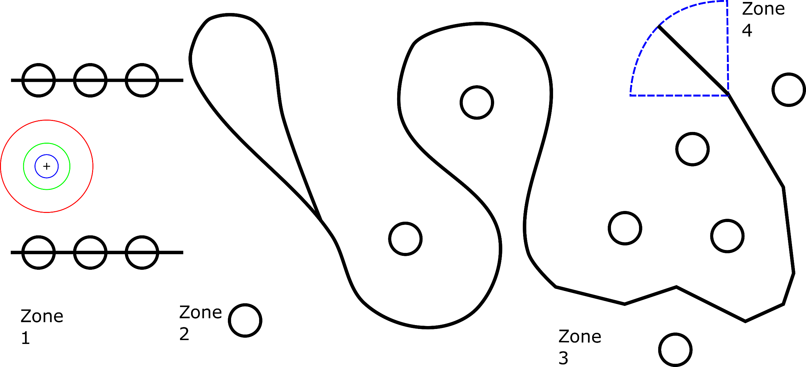
Assessment 1:
Notes:
For coursework 1, your robot will have to follow a line something like this.
Each ‘zone’ of the line challenge presents learning challenges for you.
Each of these challenges is supported with the lab sessions.
We will review this in more detail with the CW1 specification sheet.

Slide 18
Assessment 1:
20 Points
Notes:
For coursework 1, your robot will have to follow a line something like this.
Each ‘zone’ of the line challenge presents learning challenges for you.
Each of these challenges is supported with the lab sessions.
We will review this in more detail with the CW1 specification sheet.

Slide 19
Assessment 1:
15 Points
Notes:
For coursework 1, your robot will have to follow a line something like this.
Each ‘zone’ of the line challenge presents learning challenges for you.
Each of these challenges is supported with the lab sessions.
We will review this in more detail with the CW1 specification sheet.

Slide 20
Assessment 1:
25 Points
Notes:
For coursework 1, your robot will have to follow a line something like this.
Each ‘zone’ of the line challenge presents learning challenges for you.
Each of these challenges is supported with the lab sessions.
We will review this in more detail with the CW1 specification sheet.

Slide 21
Assessment 1:
5 Points
Notes:
For coursework 1, your robot will have to follow a line something like this.
Each ‘zone’ of the line challenge presents learning challenges for you.
Each of these challenges is supported with the lab sessions.
We will review this in more detail with the CW1 specification sheet.

Slide 22
Assessment 1:
0 - 35 Points
Notes:
For coursework 1, your robot will have to follow a line something like this.
Each ‘zone’ of the line challenge presents learning challenges for you.
Each of these challenges is supported with the lab sessions.
We will review this in more detail with the CW1 specification sheet.

Slide 23
Advice on working with Robots (& Arduino)
Always debug from hardware up to software
Your code might be perfect, the robot and environment present problems.
Keep your wiring neat and use a convention (e.g., red = 5v, black = 0v).
Don’t plug something in unless you need it.
Always re-check your wiring.
Remember that batteries run out (and weird things happen at low volts).
Try to solve small problems, and build up complexity.
Keep a previous version of working software.

Slide 24
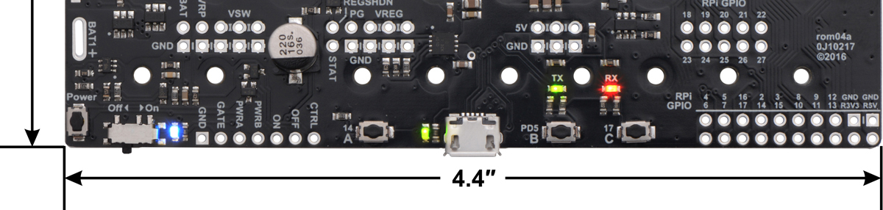
The Romi Power Button
Blue Light = On, Using Battery Power
Blue Light = Off, USB Power Only
Power Latch
Just Ignore this.
Leave “off”.
Power Button
Press on / off

Slide 25
Expectations (What do I have to do?)
This is about Experimentation with Robotic Systems
Understand something by designing experiments, and persisting until it works
It is recommended you keep a log book
Be prepared to investigate, explore and be curious
Practice being critical of how things work, and how well they work.
Robotic Systems: “Jack-of-all-Trades, Master of None”.
There will be lots you might not understand – that is O.K.
This Unit is about appreciation for robotic sub-systems
This Unit is about exposure to a whole robotic system
We want to see a critical understanding and evaluation of Robotic Systems
Lots of self-d
irected work
It is O.K to search for answers on Google, StackExchange.com, etc
Notes:
This unit might be different to what you are used to.
It is not about memorising facts or theory.
It is about putting skills into practice.
It will require you to think about how to apply skills to solve problems.
In this way, this module is about experimentation with robotics.

Slide 26
Expectations (What do I have to do?)
This is about Experimentation with Robotic Systems
Understand something by designing experiments, and persisting until it works
It is recommended you keep a log book
Be prepared to investigate, explore and be curious
Practice being critical of how things work, and how well they work.
Robotic Systems: “Jack-of-all-Trades, Master of None”.
There will be lots you might not understand – that is O.K.
This Unit is about appreciation for robotic sub-systems
This Unit is about exposure to a whole robotic system
We want to see a critical understanding and evaluation of Robotic Systems
Lots of self-directed work
It is O
.K to search for answers on Google, StackExchange.com, etc
Notes:
This unit is also about exposing you to robotic systems.
When you finish, we want you to feel like you have worked with these systems before.
In this way, you may find that there is too much to remember or keep track of – that is OK.
Maybe approach it like wine-tasting – there are some bits you will like and others you won’t. This is useful for you to know.
Generally, we want you to be able to appreciate a whole robotic system, and for that to inform your ability to evaluate a robotic system.

Slide 27
Expectations (What do I have to do?)
This is about Experimentation with Robotic Systems
Understand something by designing experiments, and persisting until it works
It is recommended you keep a log book
Be prepared to investigate, explore and be curious
Practice being critical of how things work, and how well they work.
Robotic Systems: “Jack-of-all-Trades, Master of None”.
There will be lots you might not understand – that is O.K.
This Unit is about appreciation for robotic sub-systems
This Unit is about exposure to a whole robotic system
We want to see a critical understanding and evaluation of Robotic Systems
Lots of self-directed work, peer-learning
It is O.K to search for answers on Google, StackExchange.com, etc
Play with your Romi Robot – see what you can get it to do!
Notes:
This unit is challenging because there are 170 students!
However, you are at Masters level, and therefore it is important that you develop your ability to learn independently.
You should expect to conduct and direct your own learning.
As you progress through the unit, the lab sheets will provide less help.
You may find you need to do research.
You may find you know a lot about something already.
In either case, an effective way of learning is to talk with your peers.
Help them to understand, or ask them for help.

Slide 28
Outcomes (What will I have achieved?)
You will feel comfortable to make and program your own robot from scratch
You’ll feel O.K looking at Datasheets, code, etc.
You’ll better understand how to debug a real robot from hardware to software
You will have an understanding of all the parts of a robot, from electronics up to high-level behaviours.
Which will improve your understanding of your own specialism
Which will help to make you a stronger team member on a project
You’ll have a better understanding of how to:
Break down a problem into smaller parts (technical or task)
Construct experiments to better understand a problem
Develop potential solutions
Evaluate and justify your solution to others

Slide 29
Outcomes (What will I have achieved?)
You will feel comfortable to make and program your own robot from scratch
You’ll feel O.K looking at Datasheets, code, etc.
You’ll better understand how to debug a real robot from hardware to software
You will have an understanding of all the parts of a robot, from electronics up to high-level behaviours.
Which will improve your understanding of your own specialism
Which will help to make you a stronger team member on a project
You’ll have a better understanding of how to:
Break down a problem into smaller parts (technical or task)
Construct experiments to better understand a problem
Develop potential solutions
Evaluate and justify your solution to others

Slide 30
Outcomes (What will I have achieved?)
You will feel comfortable to make and program your own robot from scratch
You’ll feel O.K looking at Datasheets, code, etc.
You’ll better understand how to debug a real robot from hardware to software
You will have an understanding of all the parts of a robot, from electronics up to high-level behaviours.
Which will improve your understanding of your own specialism
Which will help to make you a stronger team member on a project
You’ll have a better understanding of how to:
Break down a problem into smaller parts (technical or task)
Construct experiments to better understand a problem
Develop potential solutions
Evaluate and justify your solution to others

Slide 31
Final Remarks
We will introduce Assessment 2 in more depth in Week 7
Queries outside of labs/lectures must go to the Blackboard Discussion Forum first
We’ve completely re-designed this Unit – it is all new
There might be some technical bugs, please be patient
We would love your feedback throughout
Notes:
Hopefully you know enough about CW2, but there is not much value in an in-depth discussion at this point.
We have 170 students – so please make use of the discussion boards on Blackboard. We will address queries here which will allow us the most effective way of sharing answers.
As before, we are expecting some unknown problems – we will be doing our best to make this a smooth and enjoyable experience ☺

Slide 32
What is next?
Questions?
Tomorrow, Wednesday 2nd October:
9.00am : 11.00am – Romi Hand Out, First Lab Session, Bill Brown Suite
Thursday 3rd October:
10.00am : 11.00am – Lecture, Microcontrollers, Queens 1.15
Delivered by:
Paul O’Dowd paul.odowd@bristol.ac.uk
Martin Garrad
Notes:
Please come to the Drop In session if you think you will need a bit of extra help getting started with programming.
Otherwise, we will see you at the next lecture and lab.

